Slide 1


DEPARTMENT OF ARTIFICIAL INTELLIGENCE AND MACHINE LEARNING
PROJECT PHASE II PRESENTATION
ON
“CamCtrlX – The Intelligent DVR Automation System”
PRESENTED BY
BHOOMIKA R 1VK22AI006
NITHIN GOWDA M S 1VK22AI025
SAGAR B R 1VK22AI033
YASHFEEN FATHIMA 1VK22AI045
UNDER THE GUIDANCE OF
DR. SHAILA K
PROFESSOR & HOD, DEPT OF AIML-VKIT
https://vitb.ac.in/

Slide 2




CONTENTS
Introduction
Project Survey
Problem Statement
Literature Survey
Objectives and Gaps identified
System Requirements
Technical Specifications
Software Design
Implementation –development environment
Results
Conclusions
Future Scope
References
DEPT OF AI&ML, VKIT
https://vitb.ac.in/

Slide 3
INTRODUCTION
Traditional attendance management systems rely heavily on manual processes such as punch cards, biometric fingerprint scanners, or manual registers.
These methods suffer from various limitations including time consumption, potential for proxy attendance, hardware maintenance costs, and lack of real-time monitoring capabilities.
With the advancement of artificial intelligence and computer vision technologies, there is a significant opportunity to revolutionize attendance tracking systems.
DVR automation has emerged as a transformative technology that enhances efficiency, minimizes human intervention, and improves the overall management of video recording systems.
DEPT OF AI&ML, VKIT
https://vitb.ac.in/

Slide 4
PROJECT SURVEY
A survey was conducted to understand user awareness and requirements for a DVR Automation System.
Survey tool used: Google Forms.
Objective: To identify problems faced by users in existing CCTV surveillance systems.
Questions asked:
Are people using CCTV Surveillance in daily life?
What kind of CCTV Surveillance are they using (DVR/NVR)?
What are the challenges people are facing in their CCTV Surveillance System?
DEPT OF AI&ML, VKIT
https://vitb.ac.in/

Slide 5
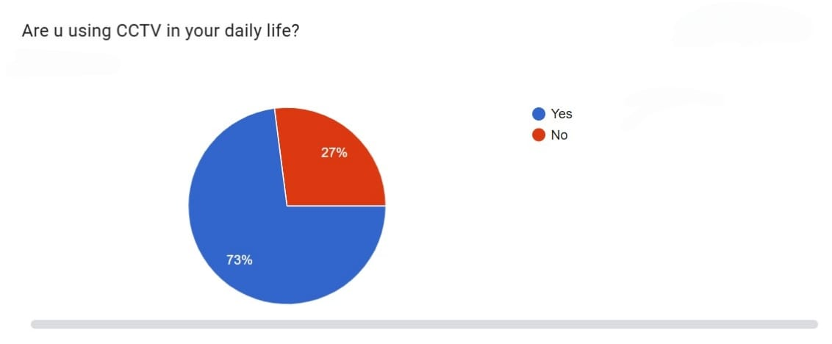
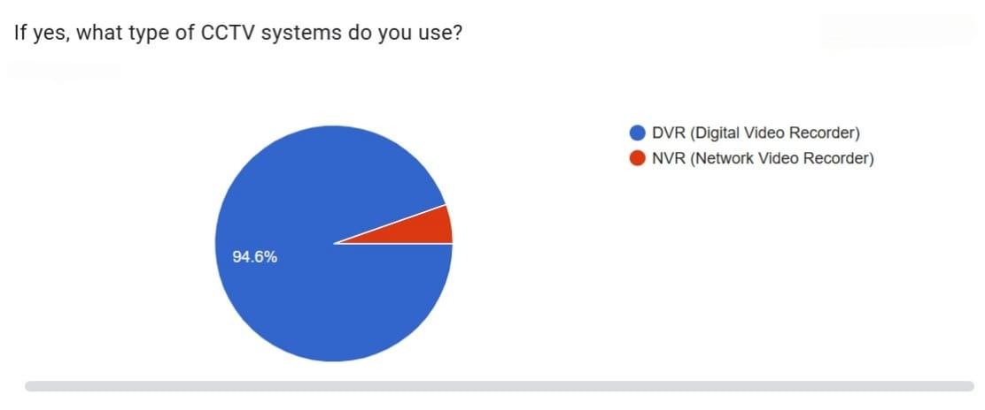
DEPT OF AI&ML, VKIT
https://vitb.ac.in/

Slide 6
PROBLEM STATEMENT
“In many organizations, employees still have to manually mark their attendance using cards or fingerprint machines. This process can be inconvenient and time-consuming, and it often depends on people remembering to check in and out correctly. Such systems can also be misused, allowing false or proxy attendance. Moreover, managers do not get real-time information about who is actually present at work, making it harder to track attendance accurately and manage the workforce efficiently.”
DEPT OF AI&ML, VKIT
https://vitb.ac.in/

Slide 7
LITERATURE SURVEY
Author | Paper Title | Objective | Methodology | Outcome
Khawla et al., [2025] | Face Recognition Smart Attendance System using Deep Transfer Learning | To develop a smart attendance system leveraging face recognition capabilities. | Utilizes Deep Transfer Learning techniques by adapting pre-trained deep learning models for the specific task of face recognition. | Likely demonstrates effective and accurate automated attendance management, leveraging the benefits of transfer learning (reduced data/training time).
Serign et al., [2025] | An Improved Face Recognition Algorithm And Its Application In Attendance Management System | To propose and apply an improved face recognition algorithm within an attendance management system. | Focuses on enhancing existing face recognition algorithms, potentially through novel pre-processing, feature extraction, or classification techniques. | Aims to achieve higher accuracy, robustness, or efficiency in face recognition for practical attendance scenarios.
Camilo et al., [2025] | Real-time Embedded Eye Detection System | To develop an eye detection system optimized for real-time operation on embedded platforms. | Focuses on efficient algorithms and potentially optimized neural network architectures suitable for resource-constrained hardware. | Achieves rapid and accurate eye detection for applications like gaze tracking or driver monitoring in embedded environments.
Yuntae et al., [2025] | Vision-based Motion Prediction For Construction Workers Safety In Real-time Multi-camera System | To apply vision-based motion prediction to enhance safety for construction workers in a real-time multi-camera setup. | Processes data from multiple synchronized camera streams to predict worker movements. | Aims to anticipate dangerous situations and potentially trigger safety warnings, improving overall worker safety.
Hobeom et al., [2024] | PASS-CCTV: Proactive Anomaly Surveillance System For CCTV Footage Analysis In Adverse Environmental Conditions | To create a proactive anomaly surveillance system for CCTV footage analysis, specifically robust to adverse environmental conditions. | Likely employs advanced image processing or deep learning techniques to handle noise, degraded video quality, and identify unusual events in challenging environments. | Demonstrates enhanced capability to detect anomalies in CCTV footage despite poor weather or lighting conditions.
DEPT OF AI&ML, VKIT
https://vitb.ac.in/

Slide 8
Author | Paper Title | Objective | Methodology | Outcome
Sultani et al., [2024] | Real-World Anomaly Detection in Surveillance Videos | To develop an anomaly detection model trained using weakly labeled real-world surveillance data. | Uses Multiple Instance Learning (MIL) with CNN feature extraction from video segments. | Achieves high anomaly detection accuracy on UCF-Crime with weak label learning.
Liu et al., [2024] | Future Frame Prediction for Video Anomaly Detection | To detect anomalies by predicting future video frames and comparing them with actual frames. | Utilizes GAN + U-Net based predictive spatio-temporal network. | Effectively detects anomalies based on prediction deviation.
Hasan et al., [2024] | Learning Temporal Regularity in Video Sequences | To learn normal temporal patterns where deviations indicate anomalies. | Uses deep autoencoder for reconstruction of normal frames. | Provides strong unsupervised anomaly detection for regular environments.
Sabokrou et al., [2023] | Deep-Anomaly: Fully Convolutional Network for Fast Anomaly Detection | To design a lightweight and fast anomaly detection model. | Uses Fully Convolutional Network (FCN) for direct anomaly detection. | Enables real-time anomaly detection suitable for DVR and edge devices.
Vu et al., [2023] | Context-aware Anomaly Detection in Surveillance Videos | To enhance detection using contextual scene understanding. | Applies attention-based CNNs with context modeling of environment-object relations. | Improves detection accuracy in complex, dynamic backgrounds.
DEPT OF AI&ML, VKIT
https://vitb.ac.in/

Slide 9
Author | Paper Title | Objective | Methodology | Outcome
Ionescu et al., [2023] | Object-Centric Autoencoders for Video Anomaly Detection | To detect anomalies by modeling object-level behavior. | Combines object detection with object-specific autoencoder reconstruction. | Achieves higher accuracy for anomalies involving specific objects or interactions.
Ramachandra & Jones, [2023] | Anomaly Detection in Streaming Surveillance Video | To detect anomalies in streaming video with low latency. | Uses an online deep learning model that updates continuously during video processing. | Supports real-time viewing and DVR-based live monitoring.
Morais et al., [2022] | Learning Motion Patterns for Anomaly Detection in Crowded Scenes | To detect anomalies in dense and crowded environments. | Uses optical flow features with LSTM-based temporal modeling. | Effective in crowded scenes like malls, stations, and public places.
Lee et al., [2022] | Spatio-Temporal Transformer for Video Anomaly Detection | To capture long-range spatial and temporal dependencies. | Uses Vision Transformer (ViT) combined with temporal attention modules. | Outperforms CNN-based models in long-sequence anomaly detection.
Huang et al., [2021] | Track Any Anomalous Object: A Granular Video Anomaly Detection Pipeline | To provide pixel, object, and frame-level anomaly detection. | Integrates segmentation, tracking, and anomaly scoring in a unified pipeline. | Achieves state-of-the-art anomaly localization, ideal for DVR automation.
DEPT OF AI&ML, VKIT
https://vitb.ac.in/

Slide 10
OBJECTIVES
Eliminate manual check-in/check-out processes through automated face recognition.
To provide easy playback, search, and backup of recorded footage using timestamps or motion events.
Develop an intuitive web-based dashboard accessible from any device
Using advanced models such as YOLOv8 to detect and track individuals with high accuracy.
To enable intelligent content recognition and classification for automated decision-making.
DEPT OF AI&ML, VKIT
https://vitb.ac.in/

Slide 11
CONTRIBUTIONS
Predictive Maintenance: Predicting potential system failures, storage issues or component malfunctions using DVR-collected data and Machine Learning algorithms.
Optimized Data Management: Improving storage allocation, data retention policies and retrieval efficiency using DVR-collected data and analytics. The optimization of surveillance and security protocols is done through automated identification of anomalies, suspicious activities and predefined events using DVR-collected data.
• Intelligent Event Detection: Automatically identify intrusion, loitering, abandoned objects, and arson using advanced
AI, models for enhanced real-time surveillance.
• Scalable & Modular Design: Support future upgrades, additional cameras, cloud storage, and new AI modules with a
flexible and extendable architecture.
Better Storage Management: The system automatically removes useless or repeated videos and saves only the important ones. This improves storage efficiency and reduces hardware load.
DEPT OF AI&ML, VKIT
https://vitb.ac.in/

Slide 12
GAPS IDENTIFIED
Data Integration: Integrating DVR-collected data with existing security management systems, alarm systems, and other decision-support tools.
Standardization: Standardizing DVR-based data collection, event logging, and analysis protocols for diverse security applications.
Scalability: Scaling up DVR automation solutions for large-scale surveillance networks with numerous cameras and recording devices.
Affordability: Making advanced DVR automation solutions affordable for small to medium-sized businesses and residential users.
Regulatory Compliance: Developing regulatory frameworks and compliance standards to support the use of automated DVR systems in various security and privacy contexts.
DEPT OF AI&ML, VKIT
https://vitb.ac.in/

Slide 13
SYSTEM REQUIREMENTS
Hardware Requirements
DVR Platform: A suitable DVR platform with reliable processing capabilities, such as a standalone DVR unit.
Camera: A high-resolution camera (e.g., IP camera or analog HD camera) for capturing continuous or motion-triggered video footage.
Sensors: Sensors for detecting environmental triggers, such as motion, light changes, or sound, to initiate recording events.
Storage: A high-capacity hard drive or SSD for storing recorded video data securely and efficiently.
Network Module: A Wi-Fi or Ethernet module for enabling remote access, cloud backup, and communication with other smart devices
Power Backup (UPS/Inverter): Ensures system stays operational during power cuts. Keeps DVR and cameras running.
DEPT OF AI&ML, VKIT
https://vitb.ac.in/

Slide 14
SYSTEM REQUIREMENTS
Software Requirements
Recording Management Software: Software for managing scheduled or event-based recordings, such as Zone Minder, Shinobi, or custom Python-based scripts.
User Interface Software: Software for live streaming, playback, and configuration, such as a web dashboard or mobile app built with Flask, React, or Android Studio.
Video Processing Software: Software for analysing and processing recorded video footage, such as OpenCV, TensorFlow.
Data Analytics Software: Software for analysing usage patterns and optimizing recording decisions, such as Python libraries, NumPy (e.g., Pandas, Scikit-learn).
Database System: Required to store event logs, timestamps, user data, and settings, SQ Lite, MySQL.
Cloud or Remote Access Services (Optional): Used for remote monitoring and backup.
DEPT OF AI&ML, VKIT
https://vitb.ac.in/

Slide 15
Computational Requirements
Processing Power: Sufficient processing power to handle real-time video processing, scheduling, and data analysis, such as a multi-core processor in a DVR unit or embedded system. Storage: Adequate storage for video data, such as high-capacity hard drives or SSDs, or cloud storage solutions for backup and access.
Reliability and High Availability: For continuous 24×7 surveillance, the computation platform must provide reliable uptime. This requires stable power, cooling, and redundancy in components like storage disks, network links, and compute nodes.
Processing Power (CPU Requirements): The CPU plays a central role in handling multiple tasks such as decoding camera video streams, managing the DVR interface, performing frame preprocessing, writing data to storage, and running background monitoring services.
DEPT OF AI&ML, VKIT
https://vitb.ac.in/

Slide 16
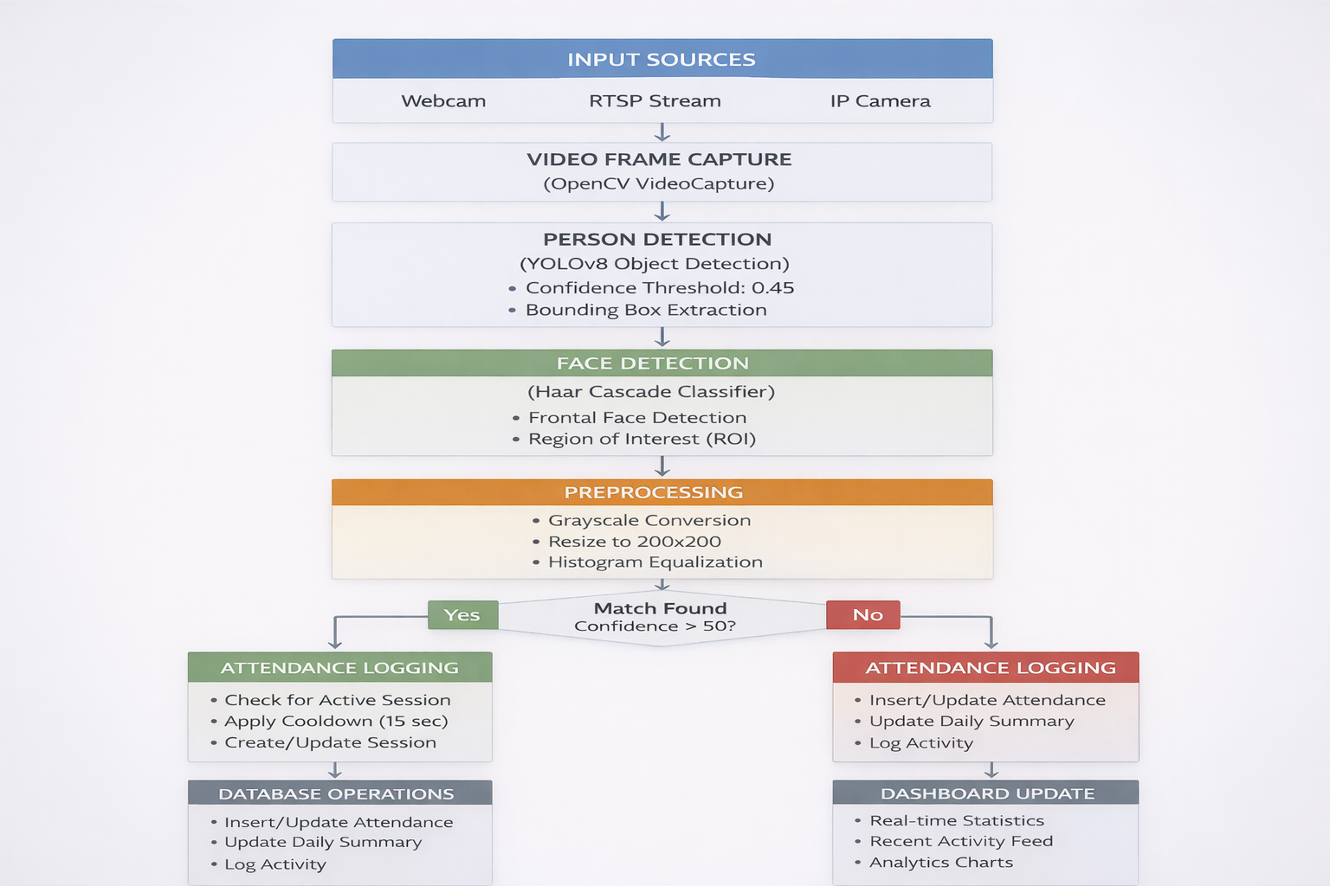
BLOCK DIAGRAM
DEPT OF AI&ML, VKIT
https://vitb.ac.in/

Slide 17
4 LEVEL IMPLEMENTATION - DEVELOPMENT ENVIRONMENT
1. LAYING THE FOUNDATION FOR EFFICIENT AUTOMATION
Emphasize the importance of a well-configured development environment for successful DVR automation.
Mention that this setup includes tools, software, and access necessary to create, test, and deploy automation solutions.
Briefly state the key components that will be covered in the following slides.
2. CORE DEVELOPMENT TOOLS & TECHNOLOGIES
Programming Language: Python
Chosen for its simplicity, readability, and strong support for automation
Extensive libraries and frameworks for rapid development
IDE: Visual Studio Code (VS Code)
Built-in debugging support
Integrated terminal and Git version control
DEPT OF AI&ML, VKIT
https://vitb.ac.in/

Slide 18
Version Control (Git):
Git is used to manage code changes efficiently, track version history, and maintain code integrity
Enables smooth collaboration among team members through controlled code sharing
Supports rollback to previous stable versions in case of errors or failures.
Platform Used: GitHub.
Backend Frameworks: Flask
Used to develop a lightweight and scalable RESTful API server.
Facilitates efficient handling of backend logic and client–server communication.
Supports easy integration with databases, machine learning models, and external services.
DEPT OF AI&ML, VKIT
https://vitb.ac.in/

Slide 19
3. SETTING UP THE ENVIRONMENT & UI CONSIDERATIONS
Local Development Environment
Required software and libraries are installed on the developer’s machine for development and testing.
Key libraries include OpenCV, Flask, NumPy, Pandas, dlib, Ultralytics, scikit-learn, and Twilio.
Virtual Environment
Python venv is used to isolate project dependencies.
Helps avoid package conflicts and ensures a stable development setup.
User Interface
A web-based user interface is developed using the Flask framework
Flask enables seamless integration between the frontend UI and backend automation logic
Focuses on usability through clear layouts, transparency effects, and intuitive user interaction suitable for automation systems
DEPT OF AI&ML, VKIT
https://vitb.ac.in/

Slide 20
4. TESTING
Testing Frameworks
Automated testing is used to ensure reliability and correctness of the DVR automation system
pytest is used as the testing framework for writing and executing test cases
Unit tests validate individual modules (detection, recognition, API logic)
Integration tests verify interaction between components such as Flask APIs, ML models, and the database
End-to-end tests help ensure the complete DVR automation workflow functions as expected
DEPT OF AI&ML, VKIT
https://vitb.ac.in/

Slide 21
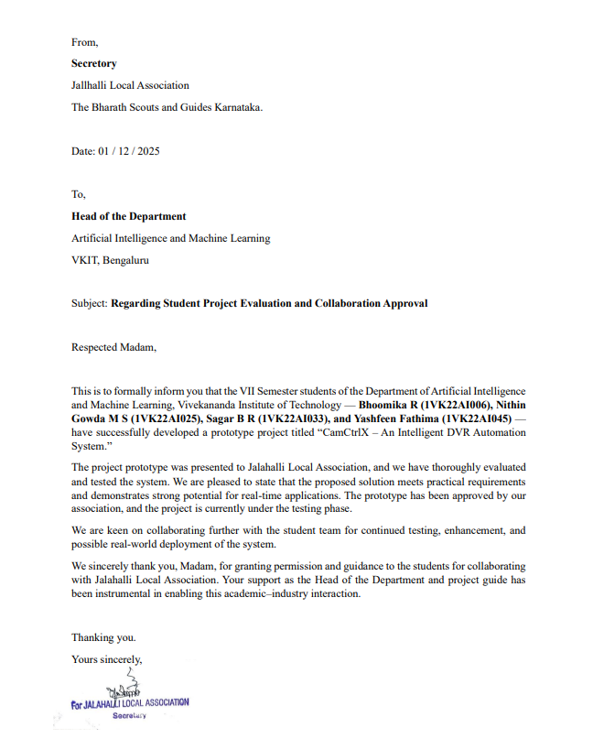
LETTER OF APPROVAL
DEPT OF AI&ML, VKIT
https://vitb.ac.in/

Slide 22
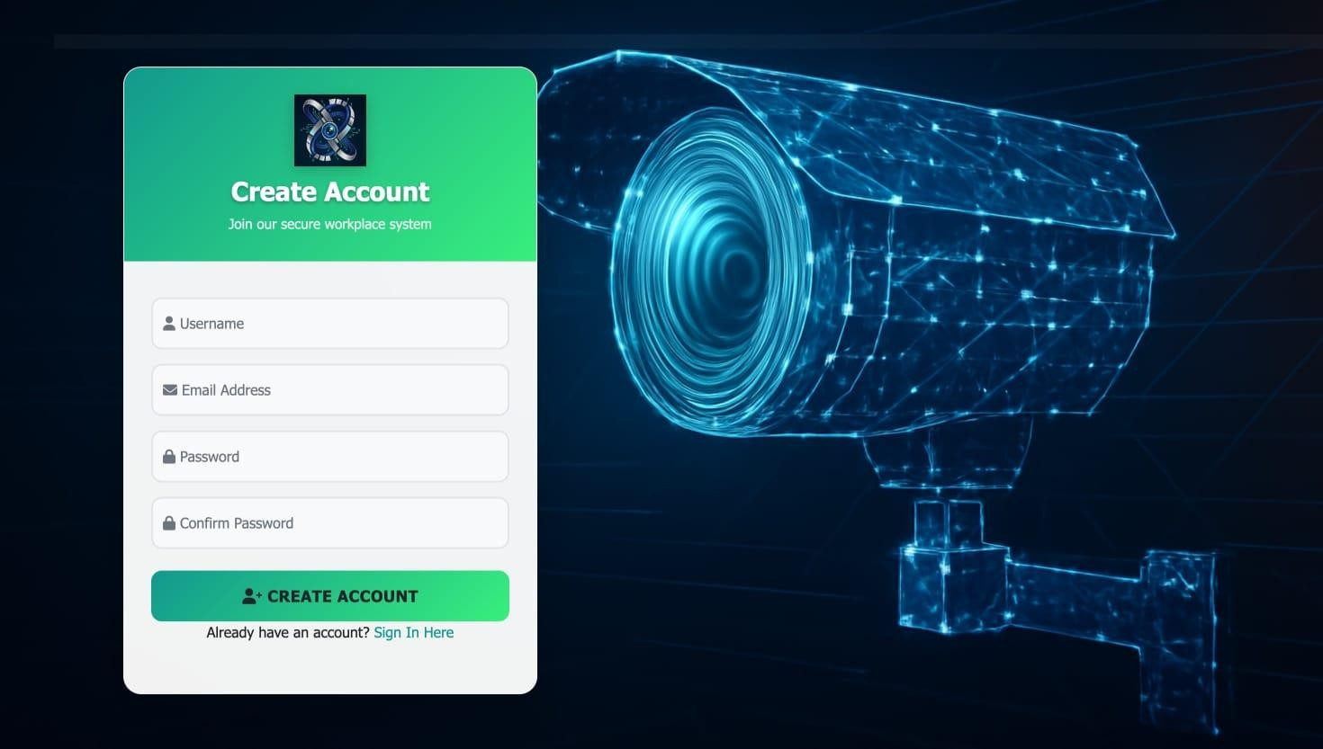
SNAPSHOTS
ACCOUNT CREATION
DEPT OF AI&ML, VKIT
https://vitb.ac.in/

Slide 23
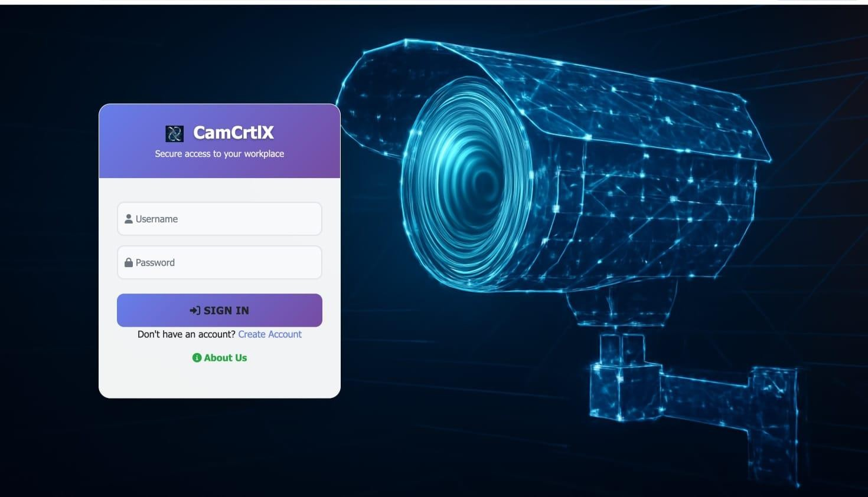
LOGIN PAGE
DEPT OF AI&ML, VKIT
https://vitb.ac.in/

Slide 24
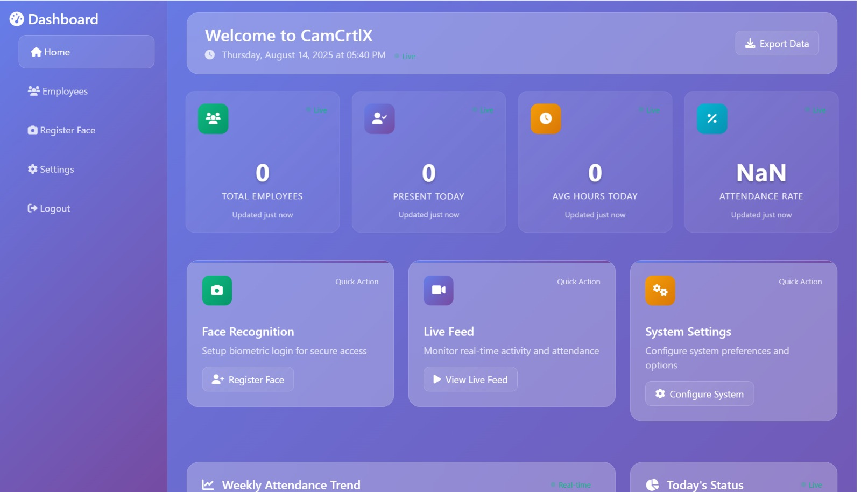
DASHBOARD
DEPT OF AI&ML, VKIT
https://vitb.ac.in/
https://vitb.ac.in/

Slide 25
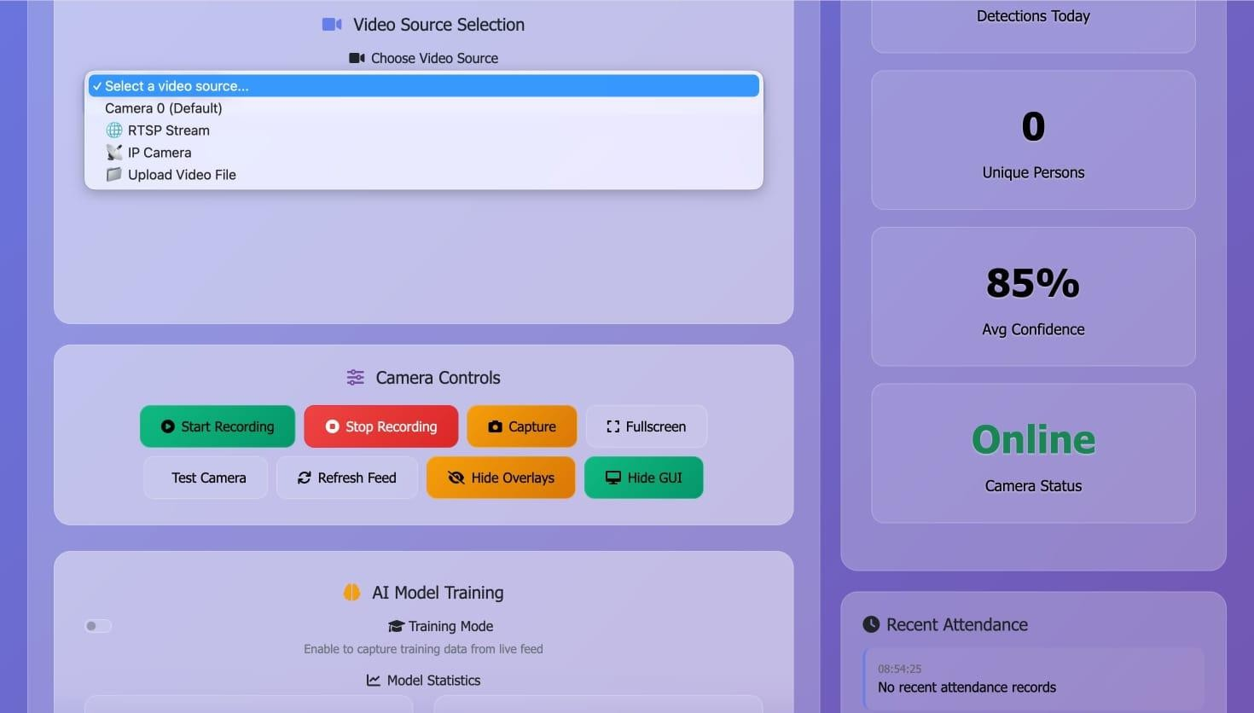
VIDEO SOURCE SELECTION
DEPT OF AI&ML, VKIT
https://vitb.ac.in/

Slide 26
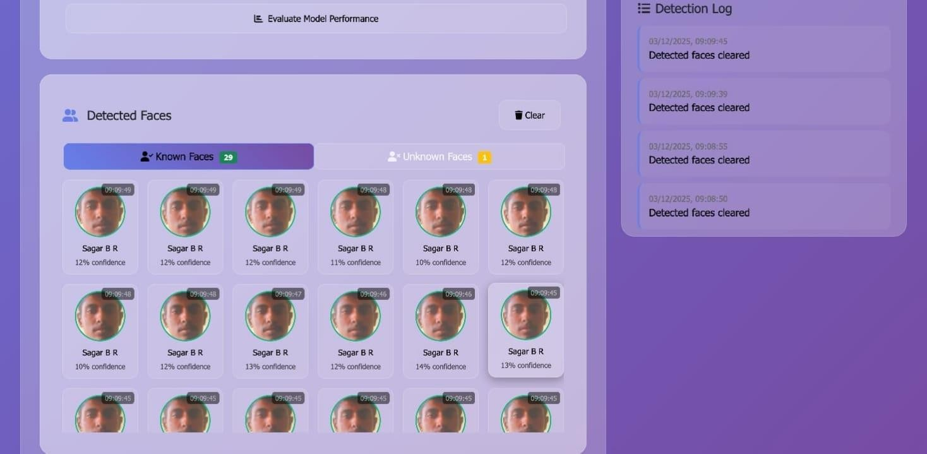
LOGS
DEPT OF AI&ML, VKIT
https://vitb.ac.in/

Slide 27
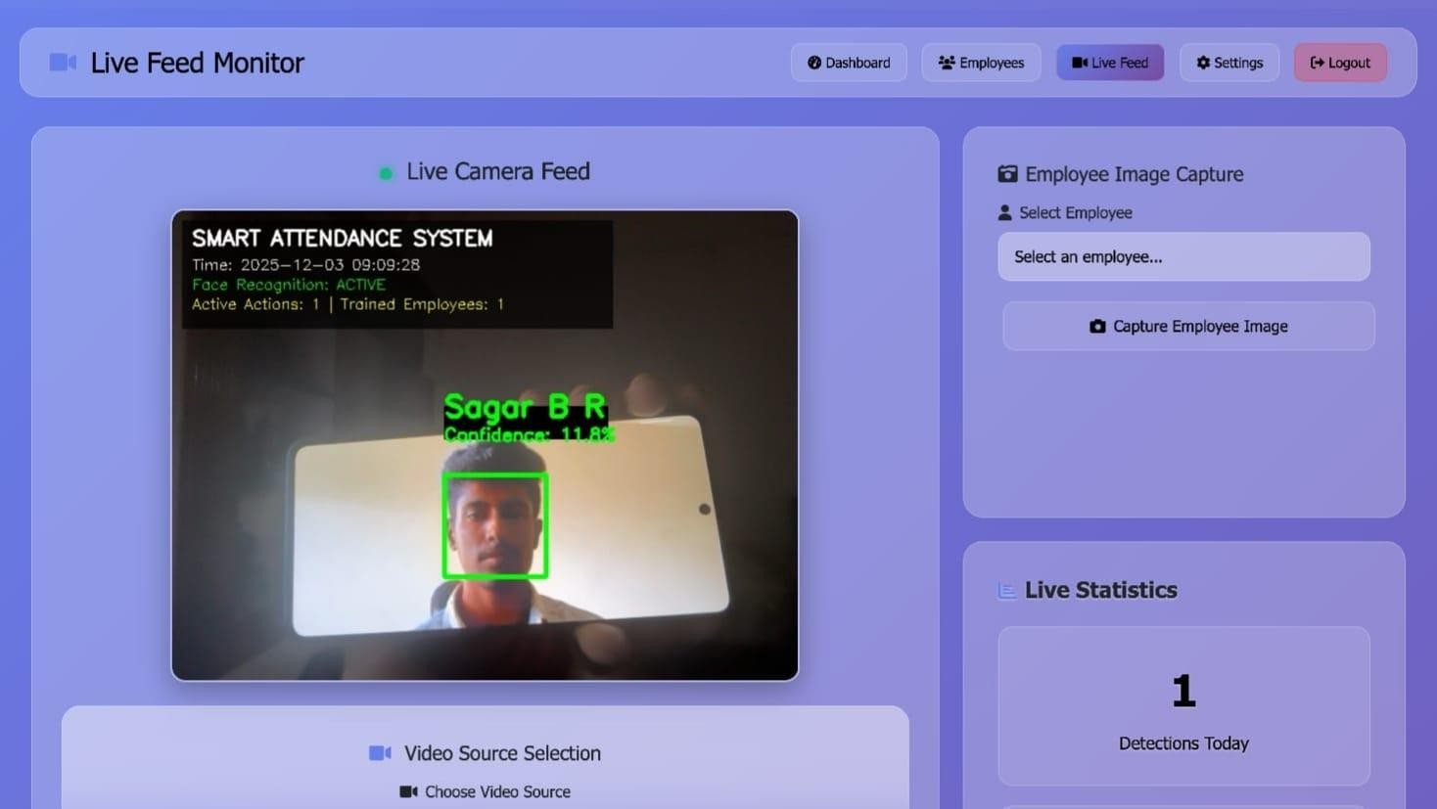
TRAINED EMPLOYEE
DEPT OF AI&ML, VKIT
https://vitb.ac.in/

Slide 28
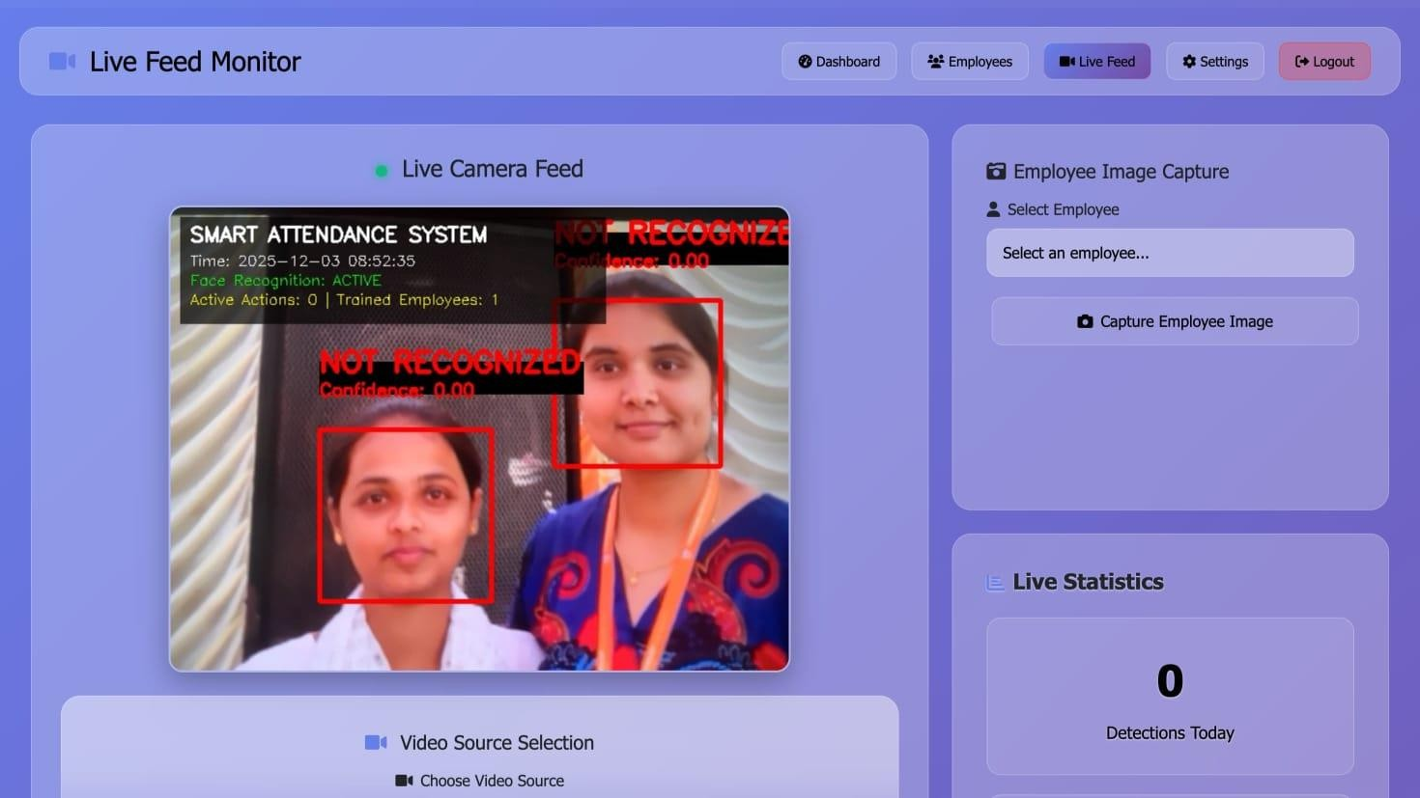
UNTRAINED EMPLOYEE
DEPT OF AI&ML, VKIT
https://vitb.ac.in/

Slide 29
CONCLUSIONS
The integration of Convolutional Neural Networks (CNN) with DVR automation offers a powerful and intelligent solution for modern video surveillance and content management.
By leveraging real-time video feeds from connected cameras, CNN models can accurately detect events, classify content, and optimize recording schedules based on user preferences or situational triggers.
This automation not only enhances monitoring efficiency but also reduces storage costs and human intervention.
The adoption of such smart DVR systems marks a significant advancement toward scalable, secure, and intelligent video management solutions.
Future developments can further improve accuracy, real-time processing, and usability across a wide range of applications including home security, broadcasting, and industrial surveillance.
Continued advancements in CNNs will improve accuracy, speed, and real-time processing.
Future systems will become more user-friendly, secure, and capable of handling complex surveillance needs.
DEPT OF AI&ML, VKIT
https://vitb.ac.in/

Slide 30
FUTURE SCOPE
Train CNN models with larger and more diverse video datasets to improve event detection and classification accuracy.
Integrate real-time decision-making for dynamic scheduling, recording, and storage management.
Utilize edge computing and AI acceleration to enable faster inference and real-time analytics on embedded DVR hardware.
More powerful edge devices (Jetson Orin, Edge TPUs) will enable on-camera AI, reducing network load and providing instant decision-making.
Cloud-based analytics will allow remote access, federated learning, and large-scale data aggregation for more robust security systems.
Using AI-based behavioural modelling, future DVRs can predict suspicious activity before it happens, improving preventive security.
DEPT OF AI&ML, VKIT
https://vitb.ac.in/

Slide 31
REFERENCES
Pingge Hu, Xiaoteng Zhang, Mengmeng Li, Yingjie Zhu, Li Shi, “TSOM: Small Object Motion Detection Neural Network Inspired by Avian Visual Circuit”, In Proc. of Neural Networks, Volume 182, 106881, 2025, ISSN 0893-6080, https://doi.org/10.1016/j. neunet.2024.106881.
Yau Alhaji Samaila, Patrick Sebastian, Aliyu Nuhu Shuaibu, Syed Saad Azhar Ali, Sulaiman Adejo Muhammad, Muhammad Sani Yahya, Isiaka Shuaibu, Isa Mohammed Sani, “Real-Time Deep Anomaly Detection: An Overview of Benchmark Datasets and Performance Metrics”, In Proc. of Transportation Research Procedia, Volume 84, pp. 418 425, 2025, ISSN 2352-1465, https://doi.org/10.1016/j.trpro.2025.03.091.
Sanxin Jiang, Hongliang Zhang, Changde Ding, ”Dual-Optimized Two-Stage Camouflaged Object Detection”, Journal of Visual Communication and Image Representation, Volume 114, 104-631, 2025, ISSN 1047-3203, https://doi.org/10.1016 /j.jvcir.2025.104631.
Ayşe Aybilge Murat, Mustafa Servet Kiran, “A Comprehensive Review on YOLO Versions for Object Detection”, Engineering Science and Technology, An International Journal, Volume 70, pp. 102-161, ISSN 2215-0986, https://doi.org/10.1016/j. jestch.2025.102161.
Paschalis Tsirtsakis, Georgios Zacharis, George S Maraslidis, George F Fragulis, “Deep Learning for Object Recognition: A Comprehensive Review of Models and Algorithms”, International Journal of Cognitive Computing in Engineering, Volume 6, pp. 298-312, 2025, ISSN 2666-3074, https://doi.org/10.1016/j.ijcce.2025.01.004.
[1]
[2]
[3]
[4]
[5]
DEPT OF AI&ML, VKIT
https://vitb.ac.in/

Slide 32
REFERENCES
[6]
[7]
[8]
[9]
[10]
Jour, Sabha, Ambreen, Selwal, Arvind, “Face Recognition-Based Intelligent Smart Home Surveillance via Real-Time Video Analysis”, A Journal on Progress in Artificial Intelligence, pp. 2192-6360, 2025, https://doi.org/10.1007/s13748-025-00410-y.
Yuntae Jeon, Dai Quoc Tran, Almo Senja Kulinan, Taeheon Kim, Minsoo Park, Seunghee Park, “Vision-Based Motion Prediction for Construction Workers Safety in Real-Time Multi-Camera System”, Advanced Engineering Informatics, Volume 62, Part D, 102898, 2024, ISSN 1474-0346, https://doi.org/10.1016/j.aei.2024.102898.
Zumaya, Rebecca, Moctezuma, Daniela, Magadán-Salazar, Andrea, “Improvement of Low-Quality Images Applied To Intelligent Video Surveillance Systems”, Journal of Signal, Image and Video Processing, Volume 19, pp. 1863-1711, 2024, https://doi.org/ 10.1007/s11760-024-03636-w.
Hobeom Jeon, Hyungmin Kim, Dohyung Kim, Jeahong Kim, “PASS-CCTV: Proactive Anomaly Surveillance System for CCTV Footage analysis in adverse environmental conditions”, In Proc. of Expert Systems with Applications, Volume 254, 124-391, 2024, ISSN 0957-4174, https://doi.org/10.1016/j.eswa .2024.124391.
Chunying Cui, Linlin Liu, Rui Qiao, “A Cutting-Edge Video Anomaly Detection Method Using Image Quality Assessment and Attention Mechanism-Based Deep Learning”, Alexandria Engineering Journal, Volume 108, pp. 476-485, 2024, ISSN 1110-0168, https://doi.org/10.1016/j.aej.2024.07.103.
DEPT OF AI&ML, VKIT
https://vitb.ac.in/

Slide 33
REFERENCES
[11]
[12]
[13]
[14]
[15]
Yuntae Jeon, Dai Quoc Tran, Almo Senja Kulinan, Taeheon Kim, Minsoo Park, Seunghee Park, “Vision-Based Motion Prediction For Construction Workers Safety in Real-Time Multi-Camera System”, In Proc. of Advanced Engineering Informatics, Volume 62, Part D, 102898, 2024, ISSN 1474-0346, https://doi.org/10.1016/j. aei.2024.102898.
Maryam Qasim, Elena Verdu, “Video Anomaly Detection System Using Deep Convolutional and Recurrent Models, Results in Engineering”, Volume 18, 101026, 2023, ISSN 2590-1230, https://doi.org/10.1016/j.rineng.2023.101026.
Camilo A. Ruiz-Beltrán, Adrián Romero-Garcés, Martín González, Antonio Sánchez Pedraza, Juan A. Rodríguez-Fernández, Antonio Bandera, “Real-Time Embedded Eye Detection System, Expert Systems With Applications”, Volume 194, 116-505, 2022, ISSN 0957-4174, https://doi.org/10.1016/j.eswa.2022.116505.
Khawla Alhanaee, Mitha Alhammadi, Nahla Almenhali, Maad Shatnawi, “Face Recognition Smart Attendance System using Deep Transfer Learning”, Procedia Computer Science, Volume 192, pp. 4093-4102, 2021, ISSN 1877-0509, https://doi.org/ 10.1016/j.procs.2021.09.184.
Serign Modou Bah, Fang Ming, “An Improved Face Recognition Algorithm and its Application in Attendance Management System”, Volume 5, 100014, 2020, ISSN 2590 0056, https://doi.org/10.1016/j.array.2019.100014.
DEPT OF AI&ML, VKIT
https://vitb.ac.in/

Slide 34
THANK
YOU!
DEPT OF AI&ML, VKIT
https://vitb.ac.in/

